Slide 1
Cascading Style Sheets (CSS)

Slide 2
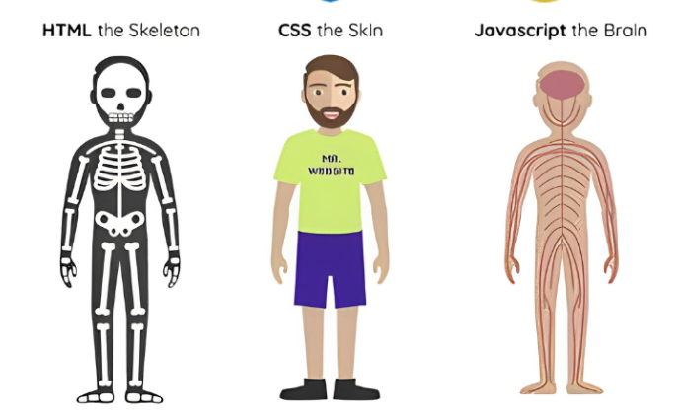
Introduction

Slide 3
Basic
color
background
background-color
background-image

Slide 4
Color mixin
transparent
hex : #778a9a
rgba: rgba(119,138,154,0.8)

Slide 5
Border
Object border
Border-width
Border-color
Border-style
Border-radius
Text border
-webkit-text-stroke

Slide 6
Display
block
inline
flex
grid
none

Slide 7
Flex
flex-direction: row|column|row-reverse|column-reverse;
flex-wrap: wrap|nowrap;
align-content:center|flex-start|flex-end|space-around|space-between|stretch;
justify-content: center|flex-start|flex-end|space-around|space-between|space-evenly;
align-items: center|flex-start|flex-end|stretch;
gap: size

Slide 8
Grid
grid-template-columns:1fr|2fr|auto|200px|repeat(3,1fr)
grid-template-rows:1fr|2fr|auto|200px|repeat(3,1fr)
grid-gap:size
grid-area: ‘header header’ ‘sidebar main’ ‘footer footer’

Slide 9
grid-template-columns|rows
grid-column-start | grid-row-start
grid-column-end | grid-column-end
minmax(200px,1fr)
auto-fill
auto-fit

Slide 10
grid-template-columns|rows
grid-column-start | grid-row-start
grid-column-end | grid-column-end
repeat
minmax(200px,1fr)
auto-fill
auto-fit

Slide 11
Position
static
relative
absolute
fixed
sticky

Slide 12
Media Query
Less — 320px : Small Mobile Device
320px — 480px: Mobile devices
481px — 768px: iPads, Tablets
769px — 991px: Small screens, laptops
992px — 1200px: Desktops, large screens
1201px and 1600px — Extra large screens, TV
1601 and more — Large Screen Board

